Slide 1
Winter Winning Camp
DATABASE MANAGEMENT SYSTEM
Department Of Career Planning & Development

Slide 2
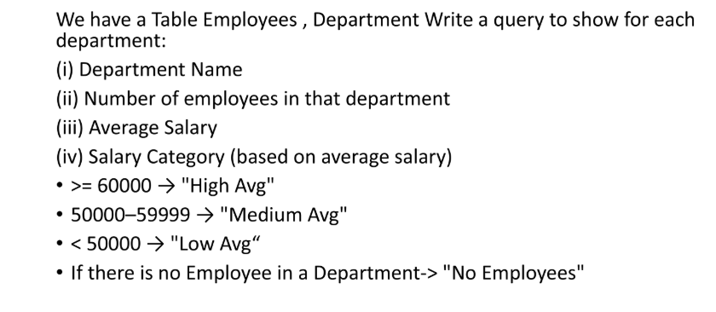
Ques 1:

Slide 3
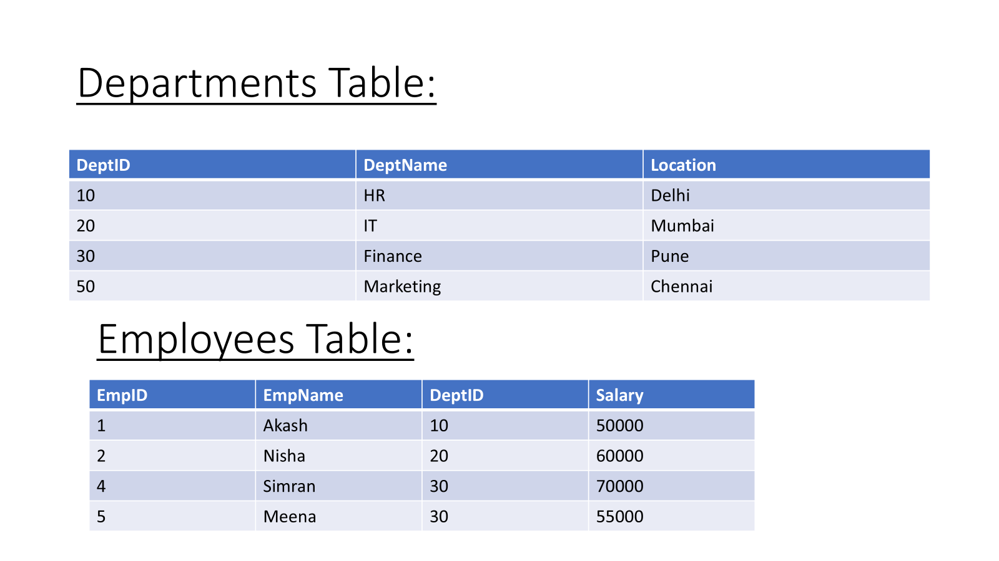

Slide 4
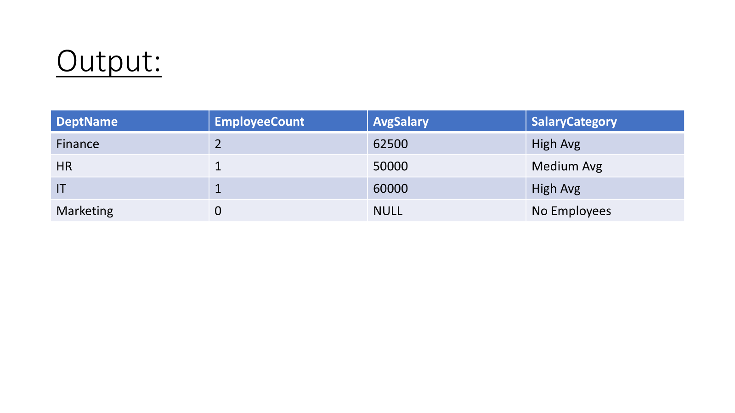

Slide 5
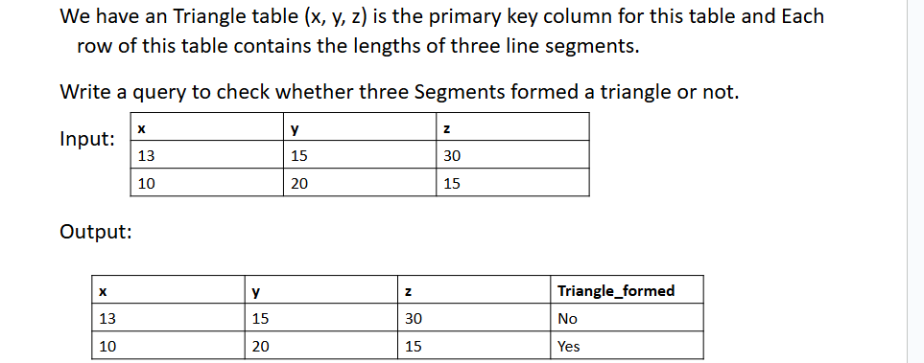
Ques 2

